Slide 1

Chapter 9 (Part 1): Graphs
Introduction to Graphs (9.1)
Graph Terminology (9.2)

Slide 2
History
Basic ideas were introduced in the eighteenth century by Leonard Euler (Swiss mathematician)
Euler was interested in solving the Königsberg bridge problem (Town of Königsberg is in Kaliningrad, Republic of Russia)
Graphs have several applications in many areas:
  Study of the structure of the World Wide Web
  Shortest path between 2 cities in a transportation network
  Molecular chemistry

Slide 3
Introduction to Graphs (9.1)
There are 5 main categories of graphs:
  Simple graph
  Multigraph
  Pseudograph
  Directed graph
  Directed multigraph

Slide 4
Introduction to Graphs (9.1) (cont.)
  Definition 1
  A simple graph G = (V,E) consists of V, a nonempty set of vertices, and E, a set of unordered pairs of distinct elements of V called edges.
  Example: Telephone lines connecting computers in different cities.

Slide 5
Introduction to Graphs (9.1) (cont.)
  Definition 2:
  A multigraph G = (V,E) consists of a set E of edges, and a function f from E to {{u,v} | u, v ∈ V, u ≠ v}. The edges e₁ and e₂ are called multiple or parallel edges if f(e₁) = f(e₂).
  Example: Multiple telephone lines connecting computers in different cities.

Slide 6
Introduction to Graphs (9.1) (cont.)
Detroit
Chicago
New York
San Fransisco
Washington
Denver
Los Angeles
A Computer network with multiple lines

Slide 7
Introduction to Graphs (9.1) (cont.)
  Definition 3:
  A pseudograph G = (V,E) consists of a set V of vertices, a set E of edges, and a function f from E to {{u,v} | u, v ∈ V}. An edge is a loop if f(e) = {u,u} = {u} for some u ∈ V.

Slide 8
Introduction to Graphs (9.1) (cont.)
Detroit
Chicago
New York
San Fransisco
Washington
Denver
Los Angeles
A Computer network with diagnostic lines

Slide 9
Introduction to Graphs (9.1) (cont.)
  Definition 4:
  A directed graph (V,E) consists of a set of vertices V and a set of edges E that are ordered pairs of elements of V.

Slide 10
Introduction to Graphs (9.1) (cont.)
Detroit
Chicago
New York
San Fransisco
Host
Washington
Denver
A Communication network with
one-way telephone lines
Los Angeles
This example shows that the host computer can only
receive data from other computer, it cannot emit

Slide 11
Introduction to Graphs (9.1) (cont.)
  Definition 5:
  A directed multigraph G = (V,E) consists of a set V of vertices, a set E of edges, and a function f from E to {{u,v} | u, v ∈ V}. The edges e₁ and e₂ are multiple edges if f(e₁) = f(e₂).

Slide 12
Introduction to Graphs (9.1) (cont.)
Detroit
Chicago
New York
San Fransisco
Washington
Denver
Los Angeles
A Computer network with multiple
one-way telephone lines

Slide 13
Graph Terminology
Theorem: An undirected graph has an even number of vertices of odd degree.
Idea: There are three possibilities for adding an edge to connect two vertices in the graph:
Before: After:
Both vertices have
even degree
Both vertices have
odd degree
Both vertices have
odd degree
Both vertices have
even degree
One vertex has odd degree, the other even
One vertex has even degree, the other odd

Slide 14
Introduction to Graphs (9.1) (cont.)
Modeling graphs
  Example: Competition between species in an ecological system can be modeled using a niche overlap graph.
  An undirected edge connect two vertices if the two species represented by these vertices compete for food.

Slide 15
Introduction to Graphs (9.1) (cont.)
Racoon
Owl
Hawk
Opossum
Squirrel
Crow
Mouse
Woodpecker
Shrew
A niche overlap graph

Slide 16
Introduction to Graphs (9.1) (cont.)
  Example: Influence of one person in society
    A directed graph called an influence graph is used to model this behavior
    There is a directed edge from vertex a to vertex b if the person represented by a vertex a influences the person represented by vertex b.

Slide 17
Introduction to Graphs (9.1) (cont.)
Linda
Brian
Deborah
Fred
Yvonne
An influence graph

Slide 18
Introduction to Graphs (9.1) (cont.)
  Example:
  The World Wide Web can be modeled as a directed graph where each web page is represented by a vertex and where an edge connects 2 web pages if there is a link between the 2 pages

Slide 19
Graph Terminology (9.2)
Basic Terminology
  Goal: Introduce graph terminology in order to further classify graphs
  Definition 1:
  Two vertices u and v in an undirected graph G are called adjacent (or neighbors) in G if {u,v} is an edge of G. If e = {u,v}, the edge e is called incident with the vertices u and v. The edge e is also said to connect u and v. The vertices u and v are called endpoints of the edge {u,v}.

Slide 20
Graph Terminology (9.2) (cont.)
  Definition 2:
  The degree of a vertex in an undirected graph is the number of edges incident with it, except that a loop at a vertex contributes twice to the degree of that vertex. The degree of the vertex v is denoted by deg(v).

Slide 21
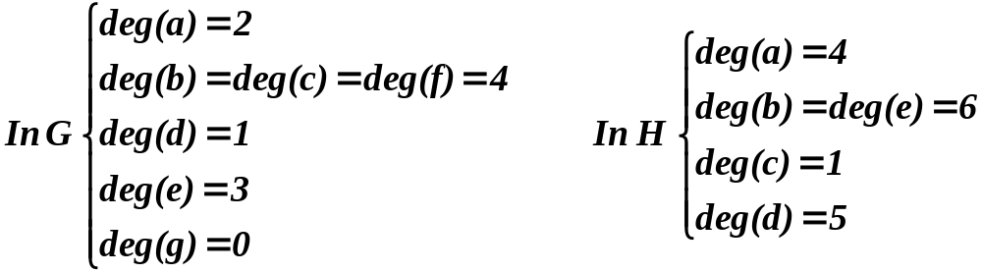
  Example: What are the degrees of the vertices in the graphs G and H?
  Solution:
b
c
d
a
b
c
a
f
e
g
e
d
G
H

Slide 22
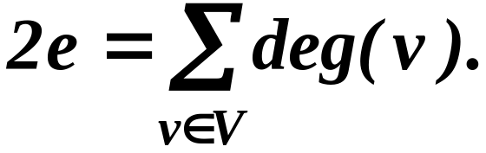
Graph Terminology (9.2) (cont.)
  Theorem 1:
  The handshaking theorem
  Let G = (V,E) be an undirected graph with e edges. Then
  (Note that this applies even if multiple edges & loops are present.)

Slide 23
Graph Terminology (9.2) (cont.)
  Example: How many edges are there in a graph with ten vertices each of degree 6 ?
  Solution: Since the sum of the degrees of the vertices is 6*10 = 60 ⇒ 2e = 60. Therefore, e = 30

Slide 24
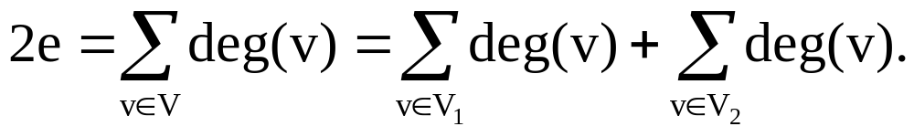
Prove that an undirected graph has an even number of vertices of odd degree.
Let V₁ and V₂ be the set of vertices of even degree and the set of vertices of odd degree, respectively, in an undirected graph G = (V,E).
Then
Since deg(v) is even for v ∈ V₁, this term is even.

Slide 25
Prove that an undirected graph has an even number of vertices of odd degree.
Furthermore, the sum of these two terms is even, since the sum is 2e. Hence, the second term in the sum is also even. (Why?) Since all the terms in the sum are odd, there must be an even number of such terms. (Why?) Thus there are an even number of vertices of odd degree.
What can we say about the vertices of even degree?

Slide 26
Graph Terminology (9.2) (cont.)
  Definition 3:
  When (u,v) is an edge of the graph G with directed edges, u is said to be adjacent to v and v is said to be adjacent from u. The vertex u is called the initial vertex of (u,v), and v is called the terminal or end vertex of (u,v). The initial vertex and terminal vertex of a loop are the same.

Slide 27
Graph Terminology (9.2) (cont.)
  Definition 4:
  In a graph with directed edges the in-degree of a vertex v, denoted deg⁻(v), is the number of edges with v as their terminal vertex. The out-degree of v, denoted by deg⁺(v), is the number of edges with v as their initial vertex.
  (Note that a loop at a vertex contributes 1 to both the in-degree and the out-degree of this vertex)

Slide 28
Graph Terminology (9.2) (cont.)
  Example: Find the in-degree and the out-degree of each vertex in the graph G
  Solution: The in-degree of G are: deg⁻(a) = 2, deg⁻(b) = 2, deg⁻(c) = 3, deg⁻(d) = 2, deg⁻(e) = 3, and deg⁻(f) = 0.
  The out-degree of G are: deg⁺(a) = 4, deg⁺(b) = 1, deg⁺(c) = 2, deg⁺(d) = 2, deg⁺(e) = 3, and deg⁺(f) = 0
a
b
c
e
f

Slide 29
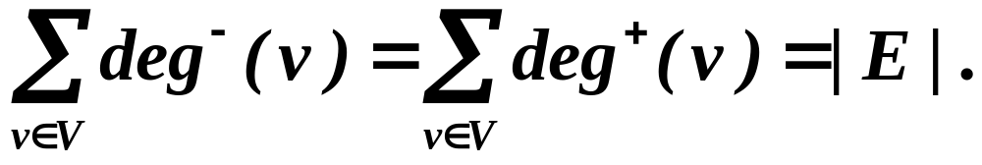
Graph Terminology (9.2) (cont.)
  Theorem 3:
  Let G = (V,E) be a graph with directed edges. Then

